Slide 1
FINAL PROJECT

Slide 2
THREAT SUMMARY
Summary of Situation: Many Hospitals are being target by a group named FIN4 taking advantage of an unpatched Windows vulnerability to execute the attack. All hospitals have a few things in common, including they all endorsed the new healthcare law that was passed.
Asset: Windows systems that contain centralized log files and backups, the patient's sensitive information, and more.
Impact: All the three are impacted :
- Confidentiality of data, which includes loss of information, usernames and passwords etc.
- Integrity in which hackers access and change data such as patient health records.
-Availability is high as no one is able to access the log's and monitor system to treat the patients. (i.e. hackers demand money to restore access to systems and data targets)
Threat Actor: The attacker group FIN4 might breach security through unpatched Windows vulnerability to execute the attack or any employe clicked on a malicious email (i.e. Employee's ignorance is also a threat to security.)
- FIN4 attacker group is an intentional external threat.
- Hospital employee's is an unintentional internal threat.
Threat Actor Motivation: Financially-motivated threat group who focus on capturing credentials authorized to access email and other non-public correspondence to target confidential information.
Common Threat Actor Techniques: The attack types leveraged include social engineering in the form of spearphishing , focuses on capturing usernames and passwords to victims’ email accounts
- Used VBA macros to display a dialog box and collect victim credentials.
- Has captured credentials via fake Outlook Web App (OWA) login pages and has also used a .NET based keylogger.

Slide 3
VULNERABILITY SCANNING TARGETS
Summary of scan targets:
Number of devices scanned: one
Device type: Main Log Server
Primary purpose of device: Store all of the logs and backup logs in data center on-site. Full backups are conducted once on the first of every month. (i.e. All the data regarding the patients healthcare is being stored here.)

Slide 4
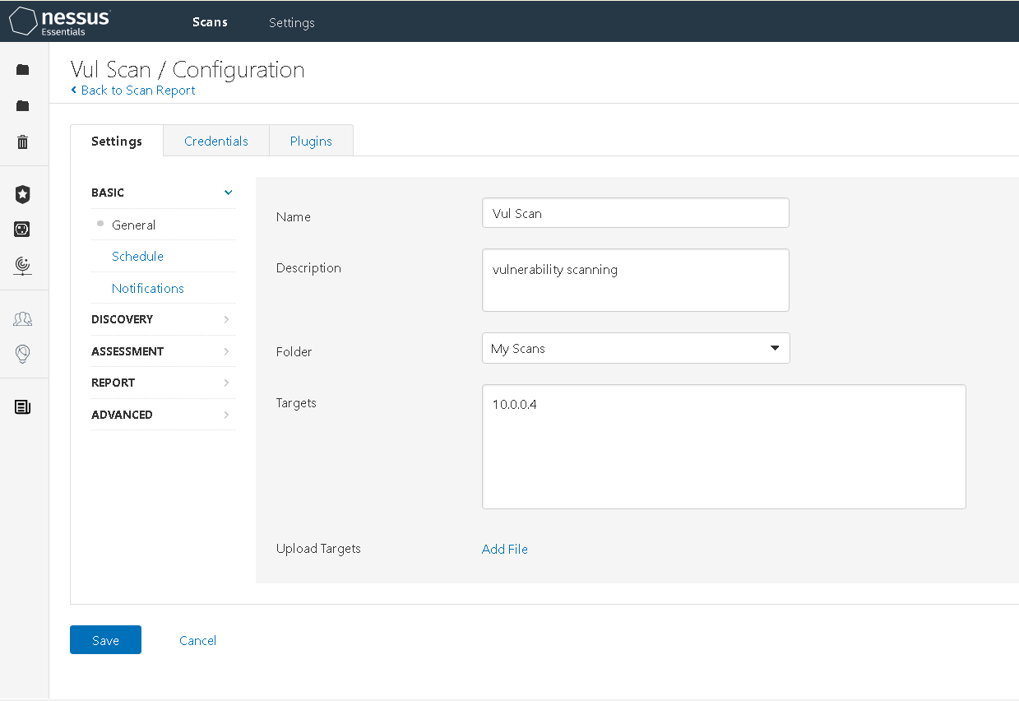
Nessus Settings Tab

Slide 5
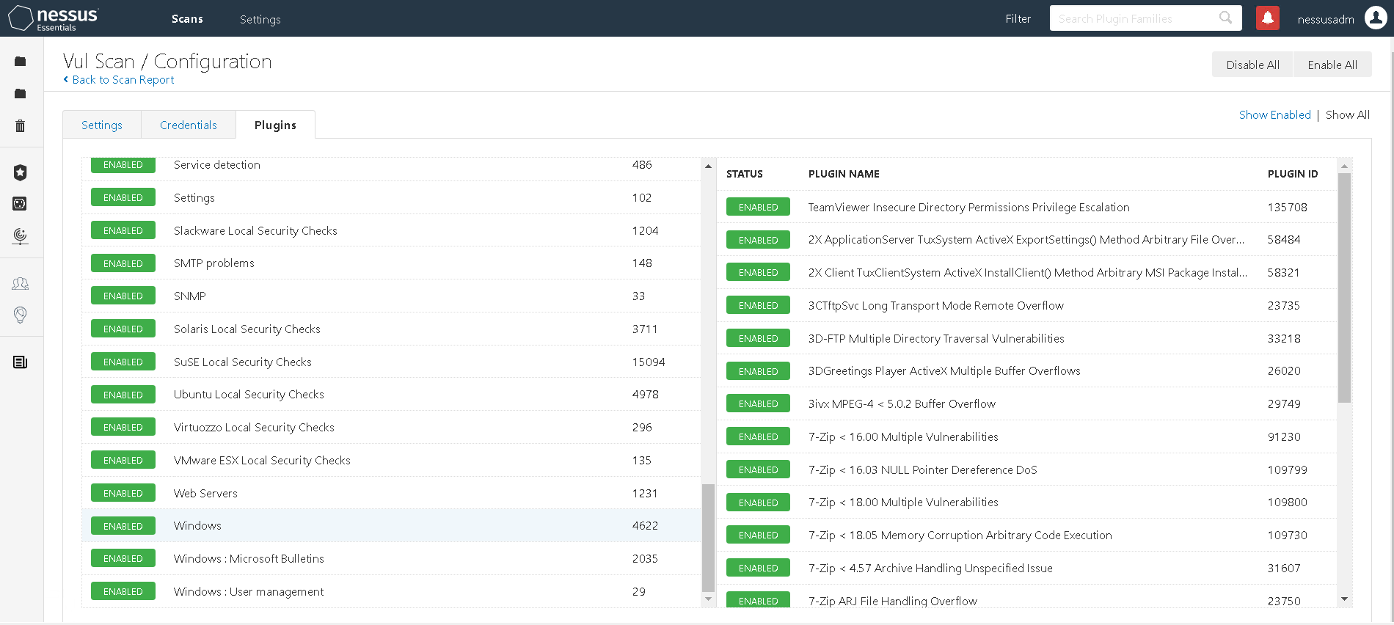
Plugins Tab

Slide 6
VULNERABILITY SCAN RESULTS
Summary of findings:
Total number of actionable findings:
Critical: None
High: None
Medium: 6
Low: None
Info : 34

Slide 7
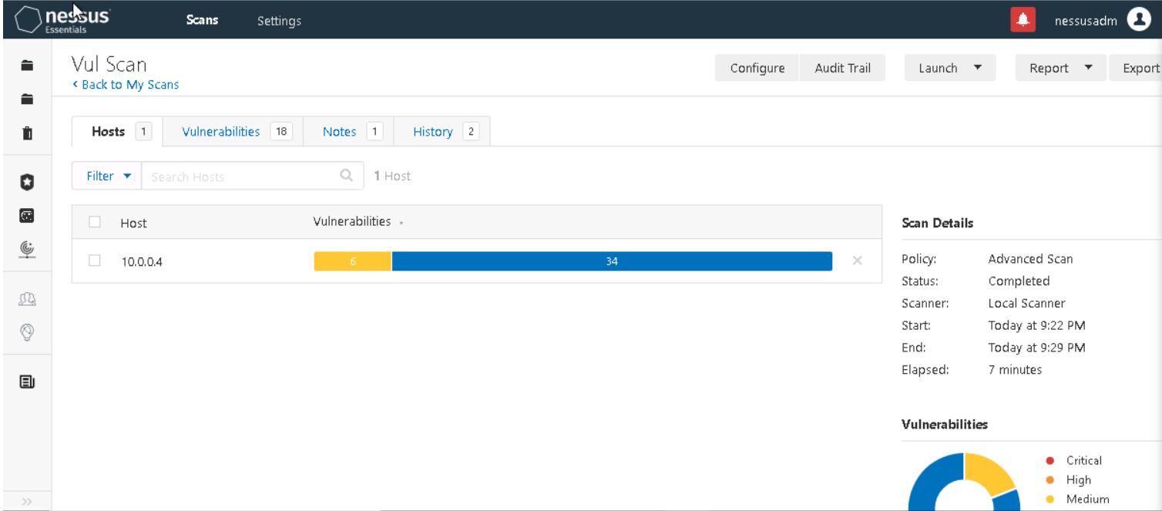
Nessus Scan Results

Slide 8
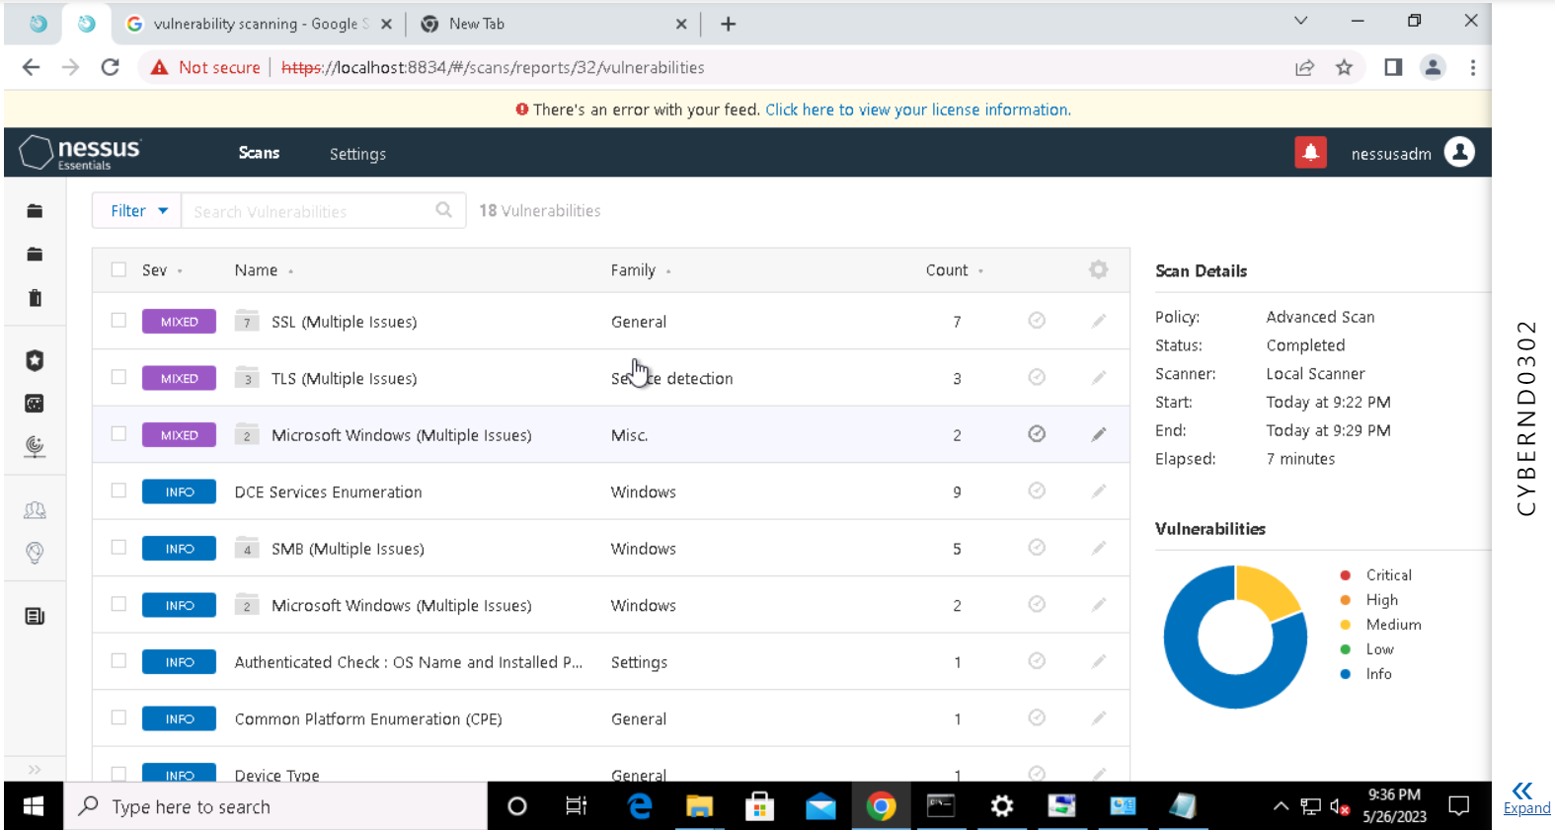
Nessus Scan Results

Slide 9
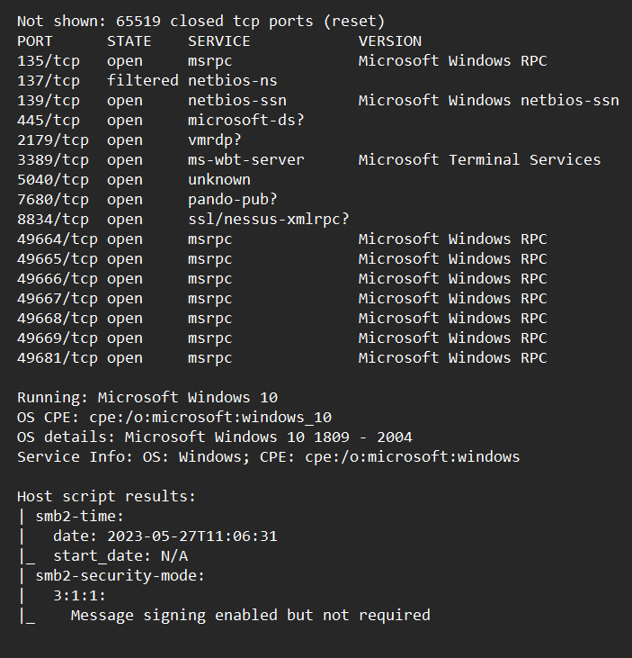
Nmap Scan Result

Slide 10
REMEDIATION RECOMMENDATION
Fix within 7 days
Finding | Severity Rating | Recommended Fix
SMB Signing not required | Medium | Enforce message signing in the host's configuration
TLS Version 1.0 Protocol Détection | Medium | Enable support for TLS 1.2 and 1.3, and disable support for TLS 1.0.
SWEET32 | Medium | Reconfigure the affected application if possible to avoid use of medium strength ciphers.
Fix within 30 days
Finding | Severity Rating | Recommended Fix
SSL Self-Signed Certificate | Medium | Purchase or generate a proper SSL certificate for this service.
SSL Certificate Cannot Be Trusted | Medium | Purchase or generate a proper SSL certificate for this service.
Fix within 60 days
Finding | Severity Rating | Recommended Fix
- | - | -
- | - | -

Slide 11
PASSWORD PENETRATION TEST OUTCOME
Methodology: Using a tool name Hashcat along with the example.dict /rockyou.txt file which contains password will test if the password can be cracked easily or not. Was successful in cracking 40 passwords and for one hash (i.e. Hashcat as password used google to crack it.)
Number of passwords tested: 41
Number of passwords cracked: 41
Recommended steps to improve passwords security: In the 21st century I should recommend a password manager to be used cuz one should not same password or same pattern everywhere. Cuz 70% of the people forget the password and instead of resetting it this should be followed.
As well as strong password policy should be implemented asap (i.e. set the group policy). As the password policy seems to be very very poor as it should be at least 14 character’s long which should include special characters, number and alphabets.

Slide 12
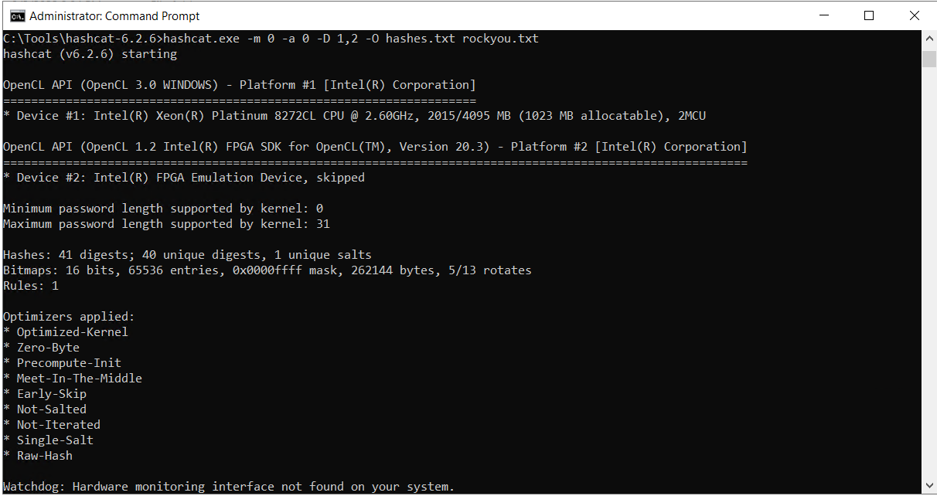
Evidence of weak passwords: Screenshot of Hachcat.

Slide 13
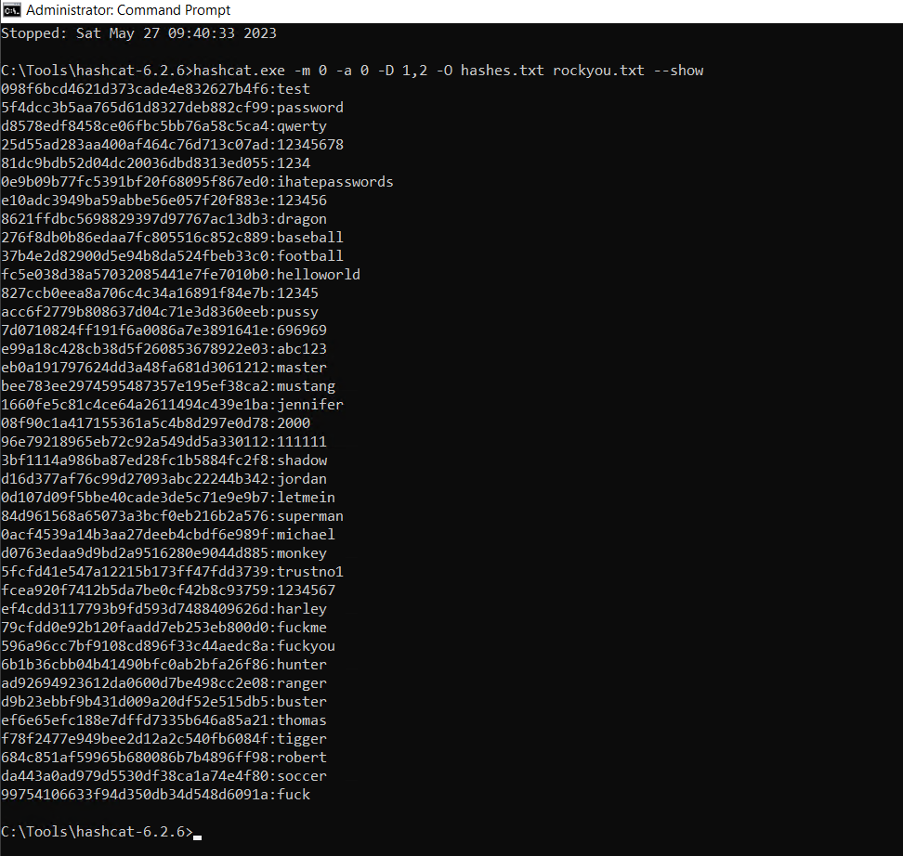
Evidence of weak passwords: Screenshot of Hachcat.

Slide 14
INCIDENT RESPONSE PRELIMINARY ASSESSMENT
Summarize ongoing incident: As to win in cyberwar, we must know about our enemy and ourself
Enemy : FIN4
FIN4 knows their targets however the scale of their operations, with targets at more than 100 public companies, coupled with their tactic of going after key individuals’ emails, sets this group apart.
Their spearphishing themes appear to be written by native English speakers familiar with both investment terminology and the inner workings of public companies.
FIN4 focuses on capturing usernames and passwords to victims’ email accounts, allowing them to view private email correspondence. (i.e. FIN4’s emails would be incredibly difficult to distinguish from a legitimate email sent)
Ourself : Windows Environment
As we came to know from the information from other hospitals that they’ve noticed that the attackers are consistently targeting Windows systems that contain centralized log files and backups as well as also taking advantage of an unpatched Windows vulnerability to execute the attack.
All hospitals have a few things in common, including they all endorsed the new healthcare law that was passed. You’ve learned from your legal team that your hospital endorsed the law as well.
From the Nessus and Nmap scan this is sure that they are taking the advantage from the vulnerability mentioned below and this is just a hypothesis at this point of time.
Vulnerability List :
smb message signing enabled but not required exploit
microsoft windows rpc exploit
MS08-068 Microsoft Windows SMB Relay Code Execution
Script rdp-vuln-ms12-020

Slide 15
INCIDENT RESPONSE PRELIMINARY ASSESSMENT
Document actions or notes from the following steps of the initial incident response checklist
Step 1: Possible sources are below who discovered about the incident
- An outside source (i.e. other hospitals that are being affected)
- Doctors , nurses and administrative staff (i.e. at this point Hospital X is also being compromised)
- The security department or a security person. (i.e. Me who is looking at the incident and try to make the situation Code 4
Step 2: Impact Considerations
What is the indicator of compromise?
The control systems used to monitor patient is being compromised which is a sign that suggest something suspicious is happening. Those suspicious signs are called indicators of compromise (IoC). When an IoC is confirmed, it typically gets labeled an incident.
What is the potential impact of the incident?
After doing more research come to know that the Hospital is under Ransome ware attack which as impacted the patients as lives are at risk cuz doctors are not able to see the patients information so that they can treat them.
Name of the System : CYBER-ND03-W10
OS : Microsoft Windows 10 1809 - 2004
IP address : 10.0.0.4

Slide 16
INCIDENT RESPONSE PRELIMINARY ASSESSMENT
Step 3: Questions on triage:
Is the incident confirmed? Or an indicator of compromise that’s not yet verified?
Monday 09:00 AM : 1st Update
At this point the IOC was not being verified and the search to do was started asap the information was passed to the cybersecurity team.
Monday 01:00 PM : 3rd Update
The incident was confirmed by the staff member of hospital X as the monitoring system was being compromised.
Is the incident contained already or still in progress?
Still in progress
Is the response urgent?
Yes it's critical as doctors can't treat the patients cuz they don't have the patients information.
Will any response alert the attacker and if so, do we care?
Yes if the price is not paid than the attacker would get the alert. But we don't care about that as we already know how they operate and do the things they shouldn't
What type of incident is this? Example: virus, worm, intrusion
Ransomware is a type of malware from cryptovirology that threatens to publish the victim's personal data or permanently block access to it unless a ransom is paid off.

Slide 17
INCIDENT RESPONSE PRELIMINARY ASSESSMENT
Step 4 :Is safety or human life at immediate risk ?
As all the system are being locked out so the patients life is at risk cuz system will get back soon from the updated that are taken monthly though there will be loss of data.
But loss of data is not that much risk cuz life will be lost if system are not come online soon so yes it's an immediate risk.
Step 5: As soon as possible, the regional threat manager at 967-123-7894 and the security operations center at 963-047-3576 of the incident. They will coordinate communication with other internal and external stakeholders.
Meeting’s should be held with legal team to know about the compliance that was implemented and HR so that they can guide the staff what to do and don’t in this type of situation.

Slide 18
INCIDENT RESPONSE RECOMMENDED ACTION
Summarize recommendation to contain, eradicate, and recover:
The situation is doomed for now but will be under control as soon as the action planned has started. Have already prioritized the vulnerability list and successfully gather the true positives list.
So will contain and will recover the systems that are being comprised so that treatment starts soon. Already have a incident plan in place which will help to speedily the task. And in the end will close the indecent documenting it after getting permission from the CIO.
Documented actions and notes from the IR checklist
Step 7: Malware response procedure
Here the hospital was hit by a ransomware attack which is type of malware so we should isolate the systems infected by the ransomware, wipe them clean, and restore systems fully from backups asap as the risk is immediate and no delay should be done.
The final step in the process is to take all of the prioritized vulnerabilities and gaps found by the company and leverage the vulnerability research information and company context to establish a remediation strategy. The strategy is typically shared with stakeholders such as leadership (i.e. CIA) or technical resources involved in fixing the gaps.
There are three main paths of action for remediation:
Avoid: Adjust program requirements or constraints to eliminate or reduce the risk. This adjustment could be accommodated by a change in funding, schedule, or technical requirements. These four are here because they are at higher risk. SMB Signing not required
(medium according to MITRE/medium nessus) SWEET32 (high according to MITRE/medium nessus)
Transfer: Reassign organizational accountability, responsibility, and authority to another stakeholder willing to accept the risk.
Accept: Acknowledge the existence of a particular risk, and make a deliberate decision to accept it without engaging in special efforts to control it. Approval of project or program leaders is required.

Slide 19
INCIDENT RESPONSE RECOMMENDED ACTION
Step 8: Even after alerting the staff about the incident regarding the attack that has been happening and not to click any attachment in the email from anyone.
Than also someone in the staff click on the attachment of the mail as a result the system got compromised and hospital x got under the ransomware attack like other hospital.
So after interview we got the know that the doctor was going to switch job and though that it was his interview related background check so he clicked and the mail came from the hospital mail was already compromised.
At first I was able to access the logs but after the incident the system got compromised so have to implement the action plan asap after CIA permission so that everything get under control.

Slide 20
INCIDENT RESPONSE RECOMMENDED ACTION
Step 9: Recommended changes the IR team make to prevent the occurrence from happening again or infecting other systems. Upon approval changes are to be implemented. Action examples are included below however, you should develop recommendations tailored to the attack at hand.
Re-install the affected system(s) from scratch and restore data from backups if necessary. Preserve evidence before doing this ?
Before formatting and start the things will like to preserve the evidence of the mail that was being clicked and the system image has been saved so that we have do a detailed research what when wrong and hospital X got compromised even after getting a head-ups.
Make users change passwords if passwords may have been sniffed ?
As the FIN4 is know for getting the password so it recommend for the user to use strong password using password manager as well as strong password policy should be carried out.
Ensure the system has been hardened by turning off or uninstalling unused services ?
Should make outbound rules for port 80 and 443 so that cyber attack like ransomware could not take place from next time. As well as see if any unwanted services or app was installed by the group.
Ensure the system is fully patched ?
Rescanning is an important step: Cuz it could fix one issue by changing a configuration, and when ran the scan again, that old issue was fixed but five new ones poped up and it almost became a game of whack-a-mole.
Be sure real time virus protection and intrusion detection is running.

Slide 21
INCIDENT RESPONSE RECOMMENDED ACTION
Step 12:Review response and update policies—plan and take preventative steps so the intrusion can't happen again.
Consider whether an additional policy or technology could have prevented the intrusion ?
Strong Password Policy and the time for update should be taken weekly rather than monthly. Cuz in this type of attack the data is being compromised and will be lost. So to keep the loss at minimum this should be followed.
Was the incident response appropriate? How could it be improved?
Yes the Incident response is appropriate as already got the heads-up and after knowing about the enemy (i.e. FIN4). It's an advantage to know the group works and what's there motto.
Though there is no silver bullet in cybersecurity which could save us. But we have taken every step and each phase from vulnerability scanning to penetrate testing the passwords. As well as good through plan for incident response but i am all ear's if anyone want to add something.
Were the incident-response procedures detailed and did they cover the entire situation? How can they be improved?
Yes and no both the incident response can be more detail for an ransomware attack as it is already on rise from couple of years. So rather than having a response plan for malware incident it would be good to have ransomware instead. And yes some steps were very detailed as well no doubt in that (i.e. like triage questions etc..)
What changes can be made to prevent a re-infection?
Employee's ignorance is also a threat to security so staff should be trained and should give a head-ups so that we could save the organization.
Password as very very poor it should be dealt with strong password asap
What lessons have been learned from this experience?
If any new compliance is being endorsed than legal team should contact the Cybersecurity team and give an head-up about the situation so if there's any vulnerability that we should be one that should discover it first and set the controls and take necessary steps.
People are the weakest point in cyber attack (i.e. Weak password has been set by staff and clicked the phishing mail)

Slide 22
Summary and Conclusion
Enemy : FIN4
Ourself : Windows 10
Malware : Ransomware
Even though after getting the head-ups from other hospitals about the incident. So we were ready for the incident and patients that were critical/operate their data was already backed up first so even the system got compromised the life could be saved.
The sad part is evening telling the RED flags regarding the phishing attack the doctor has click on the mail attachment as a result the system got compromised. Can’t blame the doctor he/she would be have a tough time doing the work and keeping this in mind. The phishing mail was very well prepared that even our alert system was not able to alert it cut it came from the other hospital that was compromised.
The good thing is that we were prepared and execute the action plan as soon as we got the green signal from the CIO.
Next time Legal team should work with Cyberteam so that this kind of attack could be prevented in the first place.
In the end the hospital staff should definitely work on their password skills. Though I was glad that every time worked in our favour this time and lives were saved which was our motto when we heard about the incident.

